Slide 1
FIFA Dataset
Data Quality
Sridhar Rangan, Sanjin Hodzic and Nitheesh Mallu
May 1st 2019

Slide 2
Libraries Used
Numpy
Pandas
Scipy
Matplotlib
Seaborn
Overview Dataset
Around 70 attributes and over 17000+ data points (players)

Slide 3
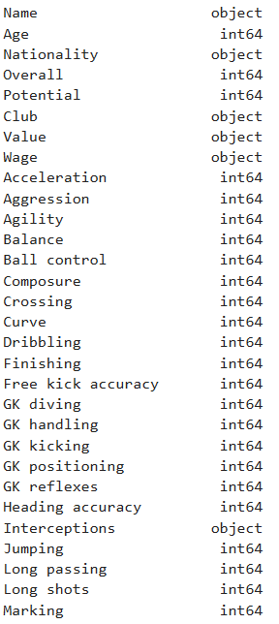

Cleaning Data
Read CSV
Trouble with mixed data types
Issues with values with + (50 + x)
Mass fixed values
Still had high vals (Triple Digit)
Again mass fixed and read in
248 Null Values removed

Slide 4
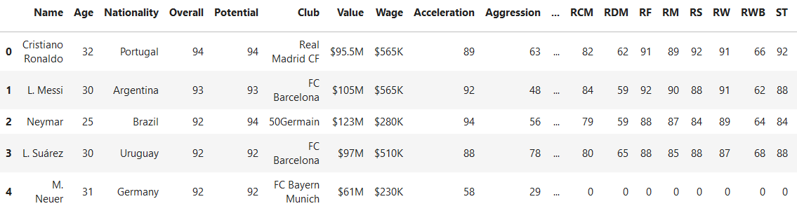
Dataset Overview

Slide 5
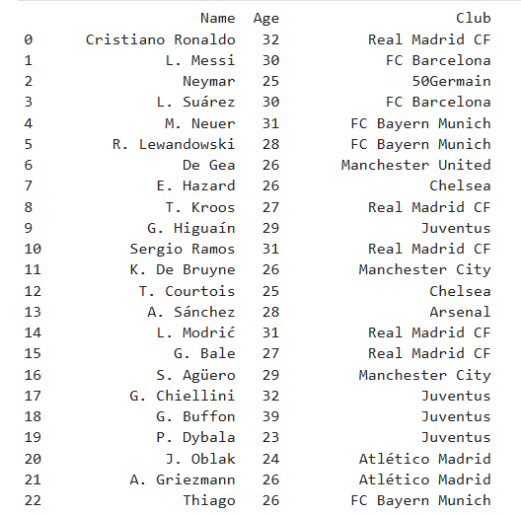
Data Understanding

Slide 6
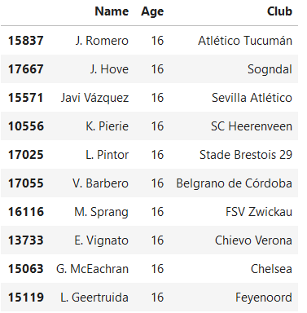
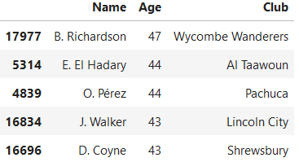
Youngest and Oldest Players

Slide 7
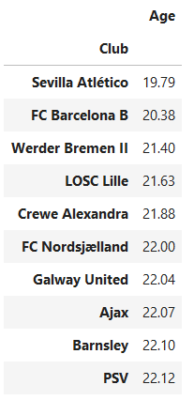

Average Age by Club

Slide 8
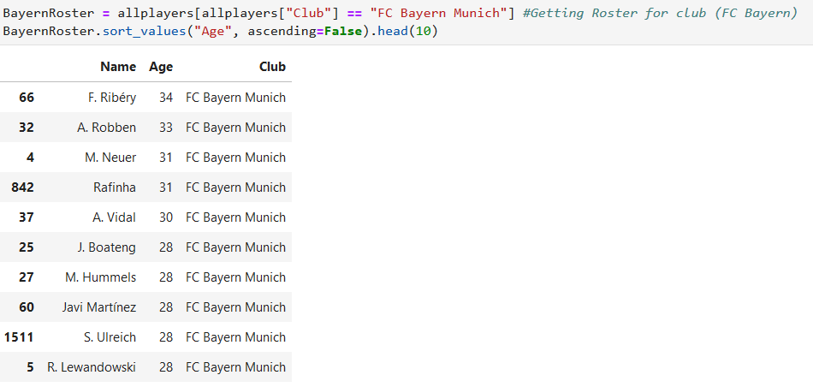
Getting Club Rosters

Slide 9
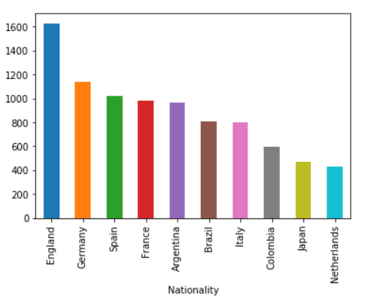
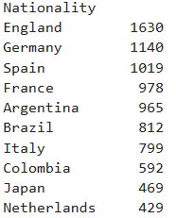
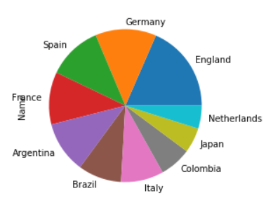
Visualization of Player Nationality

Slide 10
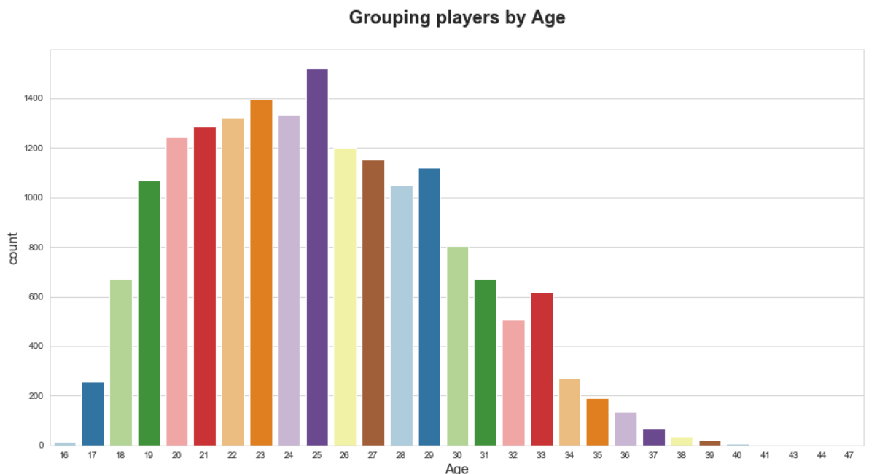

Slide 11
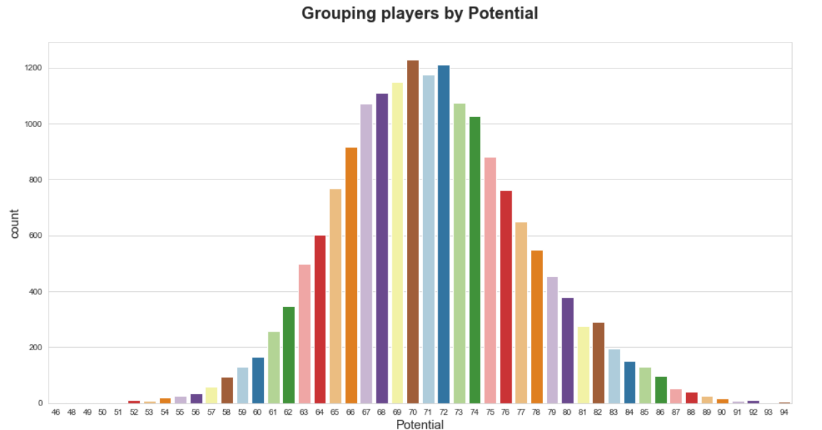

Slide 12
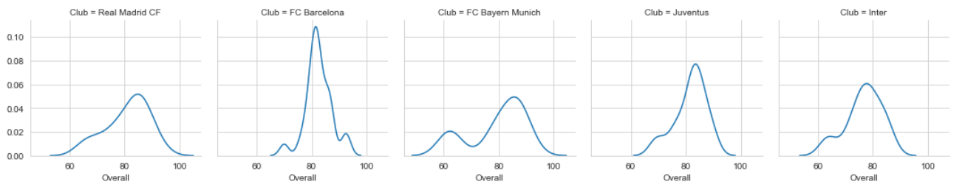
Experimenting with Facets

Slide 13
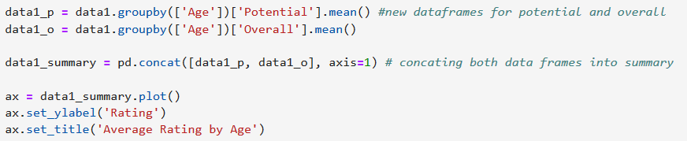
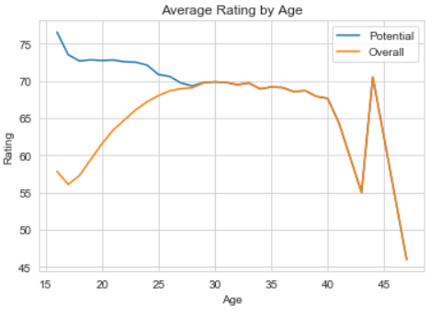
Average Rating By Age

